Slide 1

Unit 16 – Procedural Programming
with Ben Read

Slide 2
AIMS & OBJECTIVES
Discuss the benefits of modularity
Examine advanced modularisation techniques
Review the use of header files

Slide 3
MODULARISATION
Modularization is a method to organize large programs into smaller parts, i.e. the modules.
Modules can make use of an interface called a header, which advertises its services to client modules and instructs them on access methods.
Implementation of a header hides the module’s code and any other private implementation details the client modules do not need access to.

Slide 4
KEY FEATURES
Maintenance | Extension
Debugging | Speed of compilation
Distributed workload | Re-usability

Slide 5
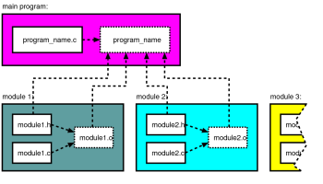
COMPILATION

Slide 6
HEADER FILES
Header files contain key information about a module. They act as an intermediary between the application calling the module and the module itself.
The header contains only declarations of constants, types, global variables and function prototypes that client programs are allowed to see and to use.
Every other private item internal to the module must stay inside the code file.

Slide 7
SYNTAX OF A HEADER FILE
//Description of the module
//Header guard words
#ifndef module1_H //If the module’s not already defined
#define module1_H //Define Module
//System headers required for the functions being declared
#include <stdio.h>
#include <stdlib.h>
//Application specific headers. Note “” as opposed to <>
#include “module2.h”
//Constant declarations
//Datatype declarations
//Global variable declarations
//Function prototype declarations
#endif //Ends the #ifndef statement

